Slide 1
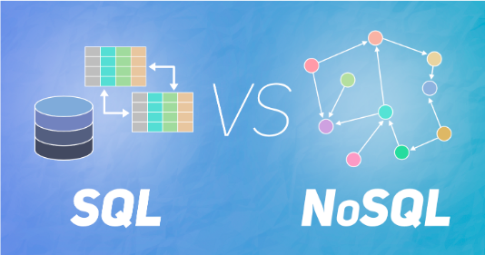
DataBase Checkpoint
GoMyCode
SQL vs NoSQL
Ben Rejeb Zied

Slide 2
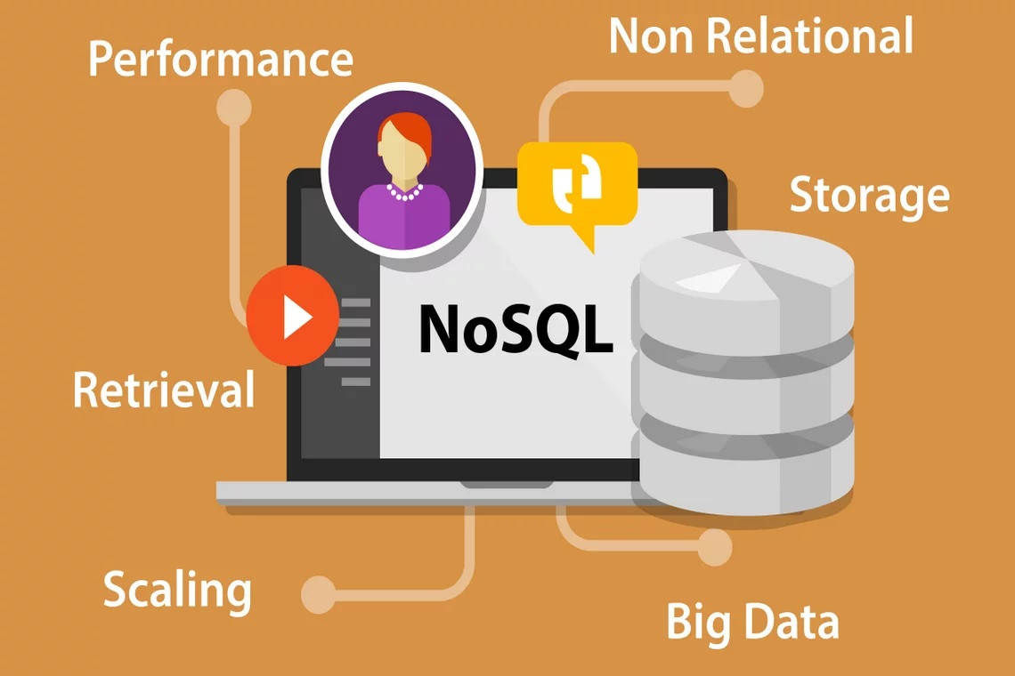
NoSQL (Not Only SQL database)
NoSQL is an approach to database management that can accommodate a wide variety of data models, including key-value, document, columnar and graph formats. A NoSQL database generally means that it is non-relational, distributed, flexible and scalable. Additional common NoSQL database features include the lack of a database schema, data clustering, replication support and eventual consistency, as opposed to the typical ACID (atomicity, consistency, isolation and durability) transaction consistency of relational and SQL databases. Many NoSQL database systems are also open source.

Slide 3

What are the types of NoSQL databases?
-Document databases
-Graph databases
-Key-value stores
-Wide-column stores
Examples of NoSQL
-MongoDB
-Apache CouchDB
-CASSANDRA
-OrientDB
-Hypertable

Slide 4
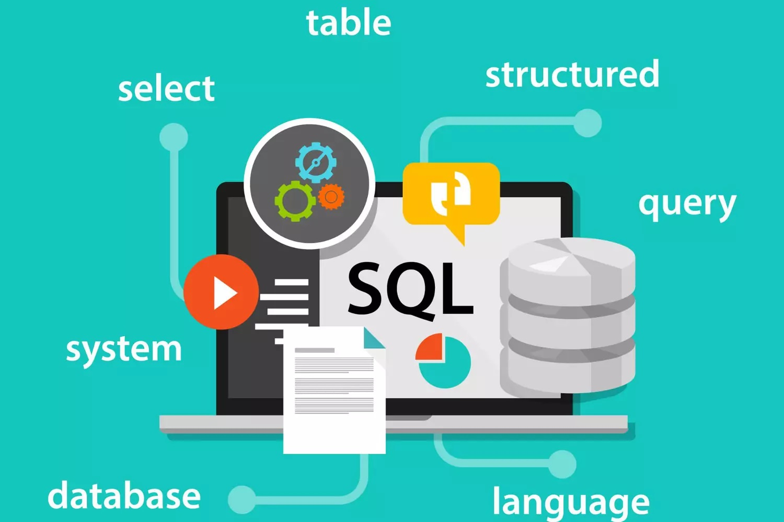
SQL (Structured Query Language)
Structured Query Language (SQL) is a programming language for storing and processing information in a relational database. A relational database stores information in tabular form, with rows and columns representing different data attributes and the various relationships between data values. You can use SQL statements to store, update, delete, search, and retrieve database information. You can also use the SQL language to maintain and optimize database performance.

Slide 5

What are the components of an SQL system?
- SQL table :
An SQL table is the basic element of a relational database. The SQL database table consists of rows and columns. Database engineers create relationships between multiple database tables to optimize data storage space.
-SQL statements :
SQL statements, or SQL queries, are valid statements that relational database management systems understand. Software developers create SQL statements using different elements of the SQL language. SQL language elements are components such as identifiers, variables, and search conditions that form a valid SQL statement.
-Stored Procedures
Stored procedures are a set of one or more SQL statements stored in the relational database. Software developers use stored procedures to improve efficiency and performance. For example, they can create a stored procedure to update sales charts instead of writing the same SQL statement in different applications.
Examples of SQL
-Microsoft SQL Server
-MySQL
-ORACLE

Slide 6
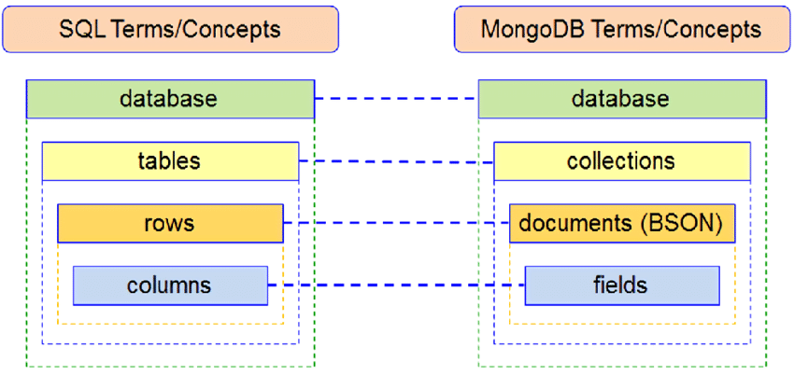
NoSQL vs. SQL: What's the difference?
At a high level, SQL databases are general purpose, whereas NoSQL databases are engineered for specific use cases. The primary differences between SQL and NoSQL can be summed up in the following five categories: API, data model, schema requirement, scalability and data integrity. Each deploys a different approach to these aspects of data storage and retrieval.

Slide 7
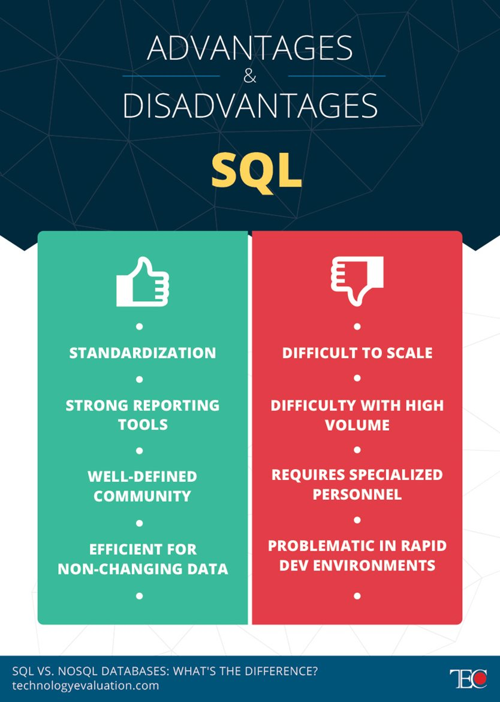
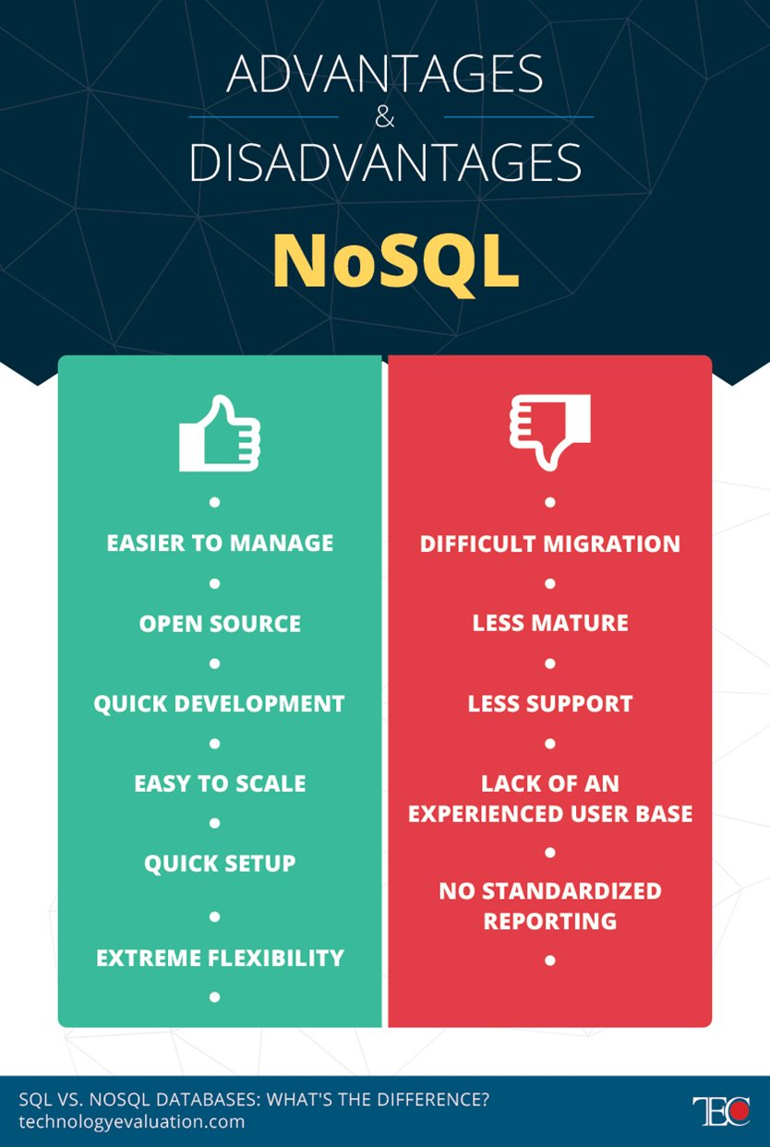

Advantages and Disadvantages

